Slide 1
Dynamic Programming Vs Monte Carlo Method
Dynamic Programming
The advantage of the DP method is that it uses the Bellman equation to compute the value of a state
According to the Bellman equation, the value of a state can be obtained as the sum of the immediate reward and the discounted value of the next state. This is called bootstrapping.
That is, to compute the value of a state, we don't have to wait till the end of the episode, instead, using the Bellman equation, we can estimate the value of a state just based on the value of the next state.
we learned that in order to find the value of a state, we didn't have to wait till the end of the episode. Instead, we bootstrap, that is, we estimate the value of the current state V(s) by estimating the value of the next state.
DP is a model-based method and we should know the transition probability in order to use it. When we don't know the model dynamics of the environment, we cannot apply the DP method.
Monte Carlo Method
The advantage of the MC method is that it is a model-free method, which means that it does not require the model dynamics of the environment to be known in order to estimate the value and Q functions.
However, the disadvantage of the MC method is that in order to estimate the state value or Q value we need to wait until the end of the episode, and if the episode is long then it will cost us a lot of time. Also, we cannot apply MC methods to continuous tasks (non episodic tasks).

Slide 2
Temporal Difference Learning - Introduction
The TD learning algorithm takes the benefits of the DP and the MC methods into account.
So, just like in DP, we perform bootstrapping so that we don't have to wait until the end of an episode to compute the state value or Q value,
And just like the MC method, it is a model-free method and so it does not require the model dynamics of the environment to compute the state value or Q value.

Slide 3
TD Learning can be classified as:
TD prediction
TD control
In the prediction method, a policy is given as an input and we try to predict the value function or Q function using the given policy. If we predict the value function using the given policy, then we can say how good it is for the agent to be in each state if it uses the given policy. That is, we can say what the expected return an agent can get in each state if it acts according to the given policy.
In the control method, we are not given a policy as input, and the goal in the control method is to find the optimal policy. So, we initialize a random policy and then we try to find the optimal policy iteratively. That is, we try to find an optimal policy that gives us the maximum return.

Slide 4
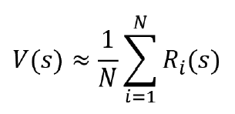




TD Prediction (TD learning update rule)
In the MC method, we estimate the value of a state by taking its return. However, a single return value cannot approximate the value of a state perfectly. So, we generate N episodes and compute the value of a state as the average return of a state across N episodes.
In TD learning, the value of a state is approximated to sort out Model dynamics requirement and Continuous task requirement as follows,
we can estimate the value of the state by only taking the immediate reward r and the discounted value of the next state .
However, a single value of cannot approximate the value of a state perfectly.So we can use the incremental mean and estimate the value of the state.
This equation is called the TD learning update rule.As we can observe, the only difference between the TD learning and the MC method is that to compute the value of the state, in the MC method, we use the full return R, which is computed using the complete episode, whereas in the TD learning method, we use the bootstrap estimate . so that we don't have to wait until the end of the episode to compute the value of the state.

Slide 5
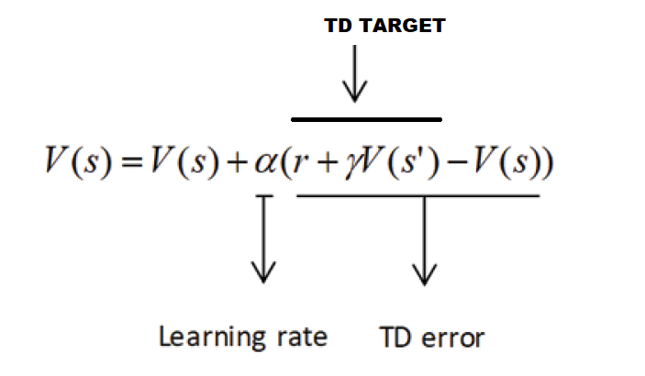
TD learning update rule basically implies:
Value of a state = value of a state + learning rate (reward + discount factor(value of next state) - value of a state)

Slide 6
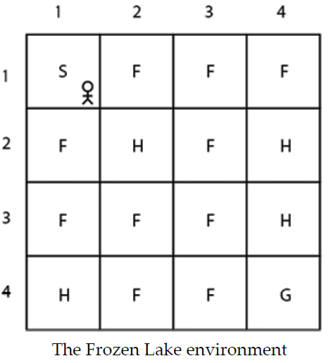
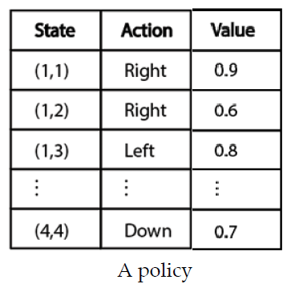
Let's explore TD prediction with Frozen Lake environment, the goal of the agent is to reach the goal state G from the starting state S without visiting the hole states H. If the agent visits state G, we assign a reward of 1 and if it visits any other states, we assign a reward of 0.
Four actions in action space, which are up, down, left, and right
16 states from S to G
Denote each action by the strings up, down, left, and right
Denote each state by their position in the grid. That is, the first state S is denoted by (1,1) and the second state F is denoted by (1,2) and so on to the last state G, which is denoted by (4,4).
In the TD prediction method, we will be given a policy and we predict the value function (state value) using a given policy.
Let's suppose we are given the following policy. It basically tells us what action to perform in each state. Also we initialize the values of all the states with random values.

Slide 7
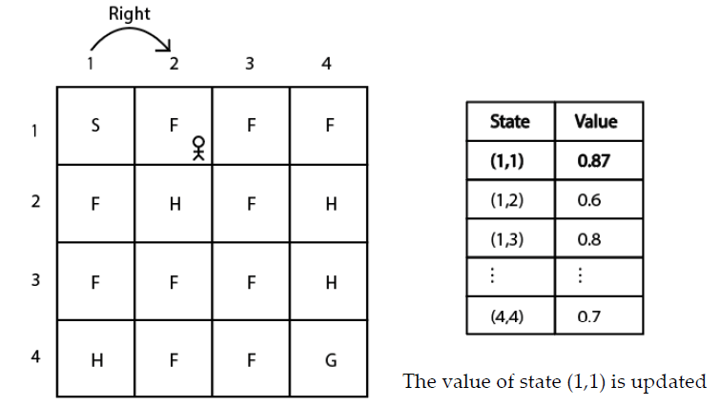

Say we are in state (1,1) and as per the given policy we take the right action and move to the next state (1,2), and we receive a reward r of 0. Let's keep the learning rate as 0.1 and the discount factor as 1 throughout this section.
Recall the TD update equation:
Substituting the value of state V(s) with V(1,1) and the next state with V(1,2) in the preceding equation, we can write:
Substituting the reward r = 0, the learning rate 0.1, and the discount factor 1
we can observe that the value of state (1,1) is 0.9 and the value of the next state (1,2) is 0.6.
Thus, the value of state (1,1) becomes
we update the value of state (1,1) as 0.87 in the value table

Slide 8


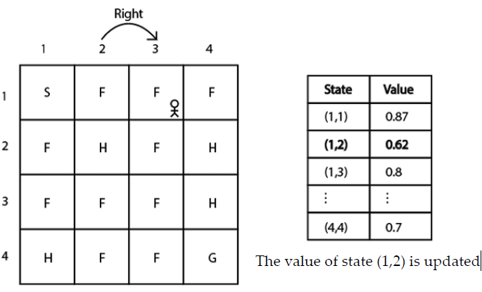
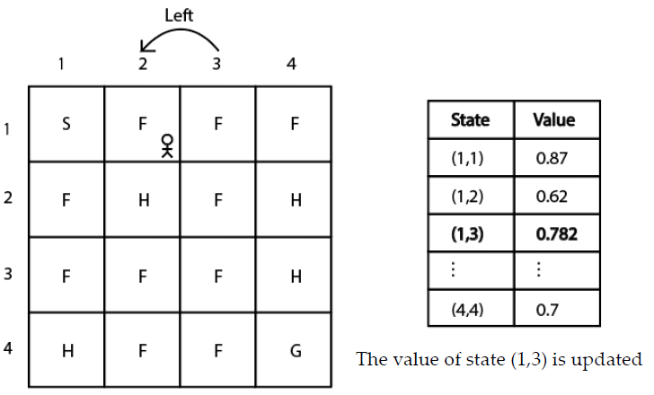
we are in state (1,2). We select the right action according to the given policy in state (1,2) and move to the next state (1,3) and receive a reward r of 0. We can compute the value of the state as,
we can observe that the value of state (1,2) is 0.6 and the value of the next state (1,3) is 0.8,
we update the value of state (1,2) to 0.62 in the value table
Similarly, we update the value of state (1,3) to 0.782 in the value table
Thus, in this way, we compute the value of every state using the given policy. However, computing the value of the state just for one episode will not be accurate. So, we repeat these steps for several episodes and compute the accurate estimates of the state value (the value function).

Slide 9

TD Control
In the on policy control, the agent behaves using one policy and tries to improve the same policy. That is, in the on-policy method, we generate episodes using one policy and improve the same policy iteratively to find the optimal policy.
In the off-policy control method, the agent behaves using one policy and tries to improve a different policy. That is, in the off-policy method, we generate episodes using one policy and we try to improve a different policy iteratively to find the optimal policy.
On-policy TD control – SARSA (State-Action-Reward-State-Action)
In TD learning, the value function is computed as
We can just rewrite this update rule in terms of the Q function as
SARSA update rule.
we initialize the Q function with random values or with zeros. Then we extract a policy from this randomly initialized Q function and act in the environment.
Our initial policy will definitely not be optimal as it is extracted from the randomly initialized Q function, but on every episode, we will update the Q function (Q values).
So, on every episode, we can use the updated Q function to extract a new policy. Thus, we will obtain the optimal policy after a series of episodes. In the SARSA method, instead of making our policy act greedily, we use the epsilon-greedy policy.

Slide 10
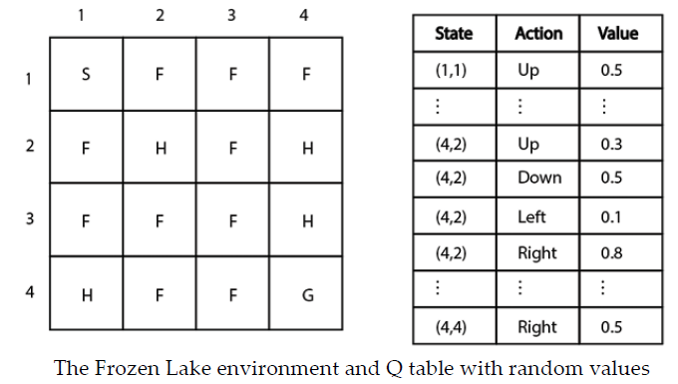
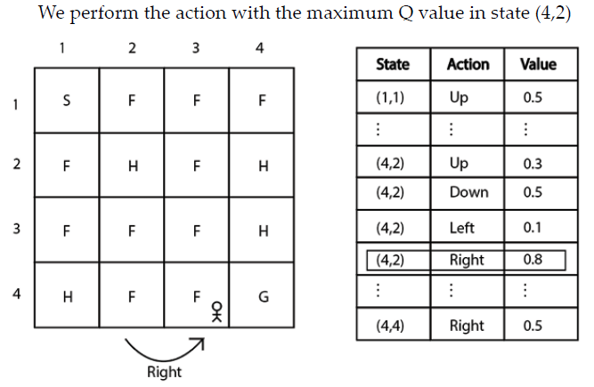

Let's consider the same Frozen Lake environment. Before going ahead, initialize our Q table (Q function) with random values.
Suppose we are in state (4,2).
Suppose we use a probability 1-epsilon and select the best action. So, in state (4,2), we move right as it has the highest Q value compared to the other actions
so, we perform the right action in state (4,2) and move to the next state (4,3)
Thus, we moved right in state (4,2) to the next state (4,3) and received a reward r of 0. Let's keep the learning rate at 0.1, and the discount factor at 1.
Substituting the state-action pair Q(s,a) with Q((4,2), right) and the next state with (4,3) in the SARSA update rule

Slide 11
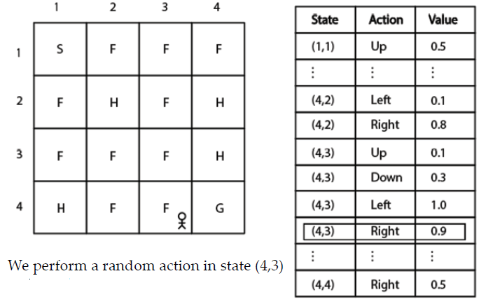

Suppose we use probability epsilon and select the random action. In state (4,3), we select the right action randomly, As you can see, although the right action does not have the maximum Q value, we selected it randomly with probability epsilon.
Thus, now update rule becomes.
Thus, substituting the value of Q((4,3), right) with 0.9
we update the Q function by updating the Q value of the state-action pair in each step of the episode.
After completing an episode, we extract a new policy from the updated Q function and uses this new policy to act in the environment. (Remember that our policy is always an epsilon-greedy policy).
We repeat this steps for several episodes to find the optimal policy.

